Slide 1
PREOSS

Slide 2
Definition of a Disadvantaged Business Enterprise. DBEs are for-profit smallbusiness concerns where socially and economically disadvantaged individuals own at least a 51% interest and also control management and daily businessoperations.

Slide 3
Criteria to Become a CERTIFIED Minority Business Enterprise (MBE) A minority-owned business is defined as being owned, capitalized, operated and controlled by a member of an identified minority group. The business must be a for-profit enterprise which physically resides in the United States or one of it territories.

Slide 4
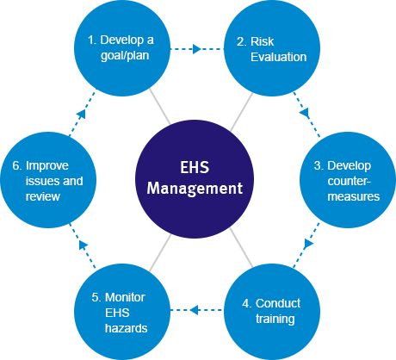
What IS PREOSS
Public Health
Risk Assessment
Environmental Impact
Occupational Health
Safety Management
Social Science

Slide 5
How major Capital projects affect the general public. The essence of PREOSS.

Slide 6
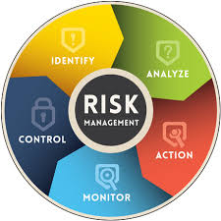
Identify
Assess
Analyze
Reduce
Control

Slide 7
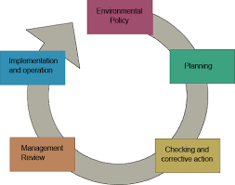
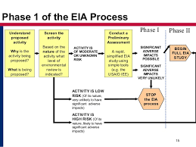
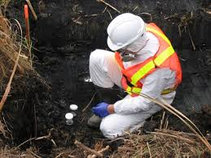
Phase I
Phase II
Hazardous Waste
C&D
Monitoring: Sound, Air, Soil, Water

Slide 9
JHA: Job Hazard Analysis
Training Programs
CWP: Construction Work Plan
Hazard Communication

Slide 11
Safety Management on work site.
Using College students

Slide 12
Teaching
Expanding by Non-profit agenda.

